Slide 1
PrEP for AGYW: How our research bolstered PrEP roll-out in Tanzania?
Sanyukta Mathur, Nanlesta Pilgrim, Catherine Kahabuka, & Neema Makyao
Making evidence accessible and usable: meaningful engagement of communities, programs, and policymakers in HIV implementation science
IAS2019, 21 July 2019

Slide 2
PrEP introduction for adolescent girls and young women (AGYW)
PrEP is a highly effective biomedical prevention technology
UNAIDS goal: 3 million PrEP users by 2020
(334,000+ current PrEP users*)
Daily oral PrEP roll-out underway, but with some mixed results
Countries need contextually-relevant information to help inform introduction & rollout of PrEP for AGYW
*https://www.avac.org/infographic/global-look-prep-introduction
Notes:
Our study was conducted in 2017 due to the continued need for more evidence to guide….

Slide 3
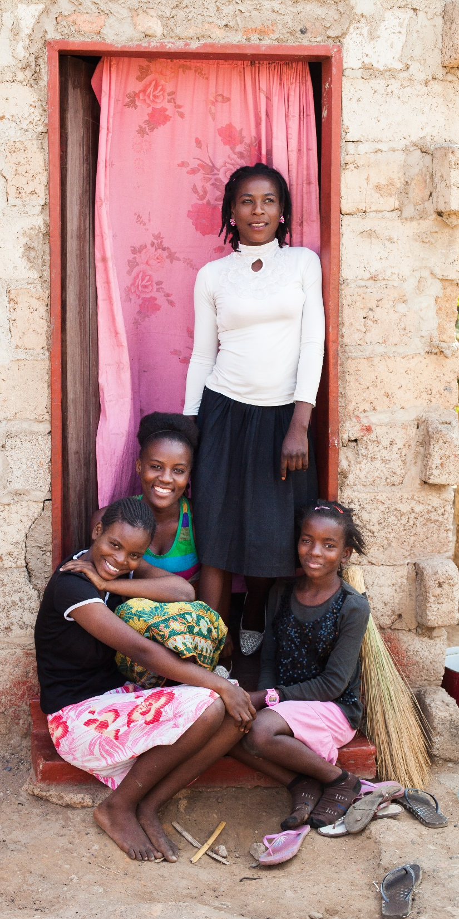
HIV among AGYW in Tanzania
AGYW in Tanzania are at high risk of HIV.
HIV prevalence among adolescent girls aged 15–19 is 1.3% and among young women aged 20–24 it is 4.4%.
PrEP has the potential to reduce HIV risk among AGYW, when taken as prescribed.
JOHN HEALEY PHOTOGRAPHY
Notes:
Background slide
Bullet 2: While there are many HIV prevention methods available…

Slide 4
Study objectives
Assess the acceptability of PrEP among AGYW, their partners and parents, providers, and key community members
Identify key facilitators and barriers for PrEP introduction to AGYW

Slide 5
How was policy influenced?
Early & continuous engagement of key stakeholders
Responsiveness
Rapid results
Country ownership
Capacity sharing

Slide 6
Early & continuous engagement of stakeholders
Engaged NACP during protocol development & as Co-PI on the study
Engaged Tz govt & other key stakeholders prior to study implementation via study initiation meeting (Feb. 2017)
Formation of research utilization committee

Slide 7
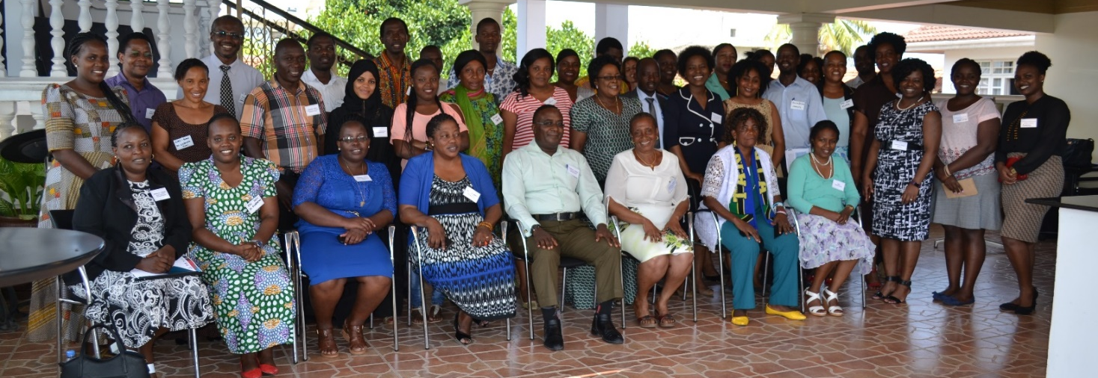
Getting the right people in the room
Ministry of Health
Prime Minister Office Regional Administration and Local Government
Regional & District Medical Officers
Regional & District AIDS Control Coordinators
District Reproductive and Child Health Coordinators
HIV Testing Coordinators
TACAIDS
NIMR
HIV providers
DREAMS implementers
UCSF
Jhpiego
SAUTI
Walter Reed
Community social organizations
Youth organizations
PLHIV organizations
Donors
CDC
Gates Foundation
Notes:
39 attendees

Slide 8
Responsive engagement
Revising study protocol
Frequent email exchanges with NACP & PEPFAR
Monthly phone calls with NACP co-investigator for study planning
Vetting of study products before public release
Release of study products to RU committee members regularly

Slide 9
Data collection: March-June 2017
Study Sites: Dar es Salaam & Mbeya
AGYW
24 in-depth interviews (IDIs)
Male partners
16 IDIs with male partners of AGYW*
Parents/guardians
8 FGDs with parents/guardians of AGYW
Partnered AGYW
FSWs
4 focus group discussions(FGDs)
Unmarried AGYW
4 male & 4 female groups
Service providers
24 IDIs
Policymakers/stakeholders
21 key informant interviews
316 surveys
*Male partners of AGYW in the community; not those of study AGYW
Notes:
In-depth interviews (IDI) with AGYW (in partnerships; FSWs) and male partners of AGYW
Focus Group discussions (FGD) with DREAMS beneficiaries and parents/guardians
Survey with health service providers
Key informant interviews (KII) with policy makers

Slide 10
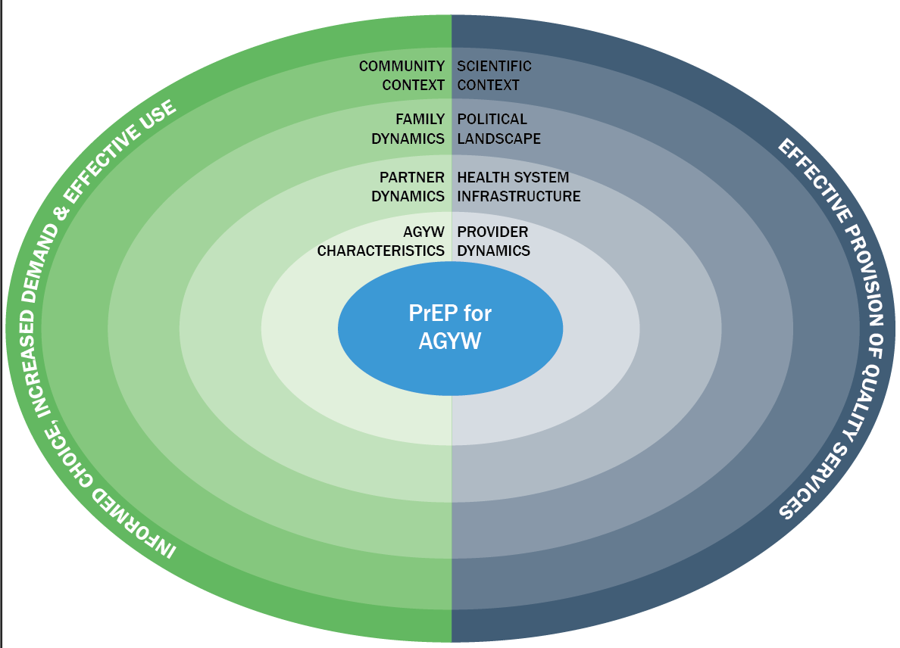
Introducing PrEP for AGYW requires multi-level considerations
AGYW, their partners, parents, and providers support AGYW access to PrEP
Lack of trust in relationships
Inconsistent or no condom use with sexual partners
Gender norms prohibiting refusal of sex with partner
Sexual violence in partnerships
Mathur, Pilgrim, and Pulerwitz. 2016. “PrEP introduction for adolescent girls & young women,” The Lancet HIV 3(9): e406-e408.
Notes:
Our IS framework positions young women in the context of their partner, peers, family, health providers and services, social values/community context, and broader scientific knowledge about PrEP. The right side (blue side) focuses on the main factors that determine the feasibility of effective introduction of quality PrEP services for AGYW. The left side (green side), focuses on the main factors that determine whether young women are able to make informed decisions around PrEP uptake and its effective use. The two sides are connected to illustrate the interplay between them, which is critical to understanding how to effectively introduce PrEP to AGYW.

Slide 11
Key considerations for PrEP introduction for AGYW
Concern about side effects & impact on fertility, cost & frequent HIV testing, HIV & sexuality–related stigma
Inclusion in partner’s decision-making process & education & availability of PrEP for themselves, cover use by AGYW could lead to mistrust in relationships
Need information and strategies to support their daughters
Concerns about being seen as condoning sexual activity and stigma
Attitudes toward adolescent girls sexuality, fear of behavioral disinhibition, short staffed, inadequate training on counseling strategies, stigma/condoning sexual activity

Slide 12
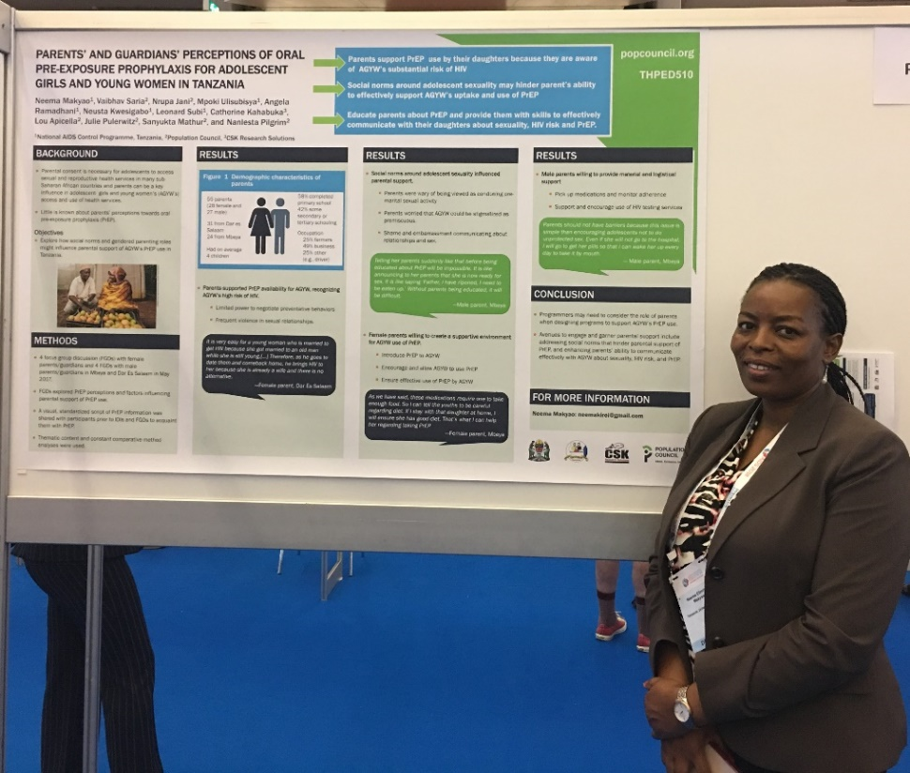
Rapid results, country ownership, & capacity sharing
SANYUKTA MATHUR
Development of a series of program and policy-oriented research briefs
Being used by USAID, CDC, MoH for advocacy and PrEP planning
Dissemination event led by NACP (Nov. 2017)
Bringing together the right stakeholders
Neema Makyao presents study results at AIDS2018

Slide 13
Research impact/use
Study replicated with MSM in Ghana
PEPFAR highlights study at annual meeting, DREAMS satellite, & annual report
Tz NACP/MOH support for additional PrEP demonstration projects
Prep Acceptability Study
(9 months)
PrEP tools/framework used for programming
…this formative assessment study and the way it was conducted is one of the main reasons the demonstration trials are now fully receiving the Ministry’s backing.
—N. Makyao, NACP, Study co-PI, Tz

Slide 14
We often encounter researchers who approach us for support of their research. Most often they want a letter of support and fail to engage us throughout the process or give us the results. We learn of the results after publication or not at all….
If researchers would work with governments more closely, we can improve the speed by which evidence informed policies and programming are made.
Neema Makyao, Study co-PI, NACP, Tanzania

